Slide 1
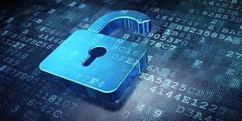
Technology Project
All About Internet Security and Supply Chain

Slide 2
What is Internet Security?
According to American-based, global computer security software company, McAfee, “Internet security consists of a range of security tactics for protecting activities and transactions conducted online over the internet”.
These security tactics are intended to protect users from threats such as hackers gaining access into computer systems, malicious software infecting and damaging computer systems, and private information being stolen.
According to McAfee, “Internet security is a specific aspect of broader concepts such as cybersecurity and computer security, being focused on the specific threats and vulnerabilities of online access and use of the internet”.

Slide 3
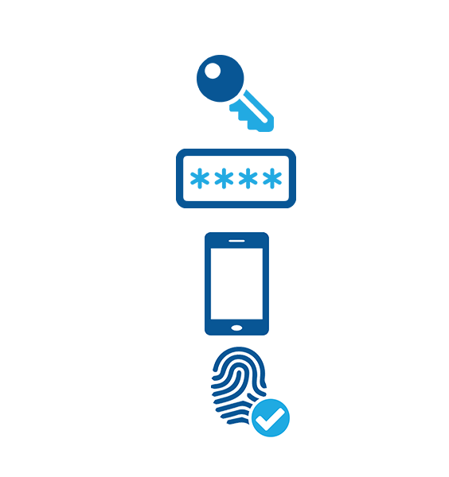
Types of Internet Security Threats
In today’s society, over half of the global population is on the internet, and therefore, billions of people’s bank information, email accounts, and other personal information are on the internet and are on their computers.
Some of the most common cyber attacks are executed through: malware (malicious software), computer worms (self-replicating software), span (potentially hazardous, unwanted messages), phishing, (scams that attempt to solicit sensitive or private information), and botnet (an infected computer network).
Several types of internet security include: secure web browsers (websites with built in security), multi-factor authentication (multiple ways to authenticate a user), email security (passwords), and firewalls (filters that can grant or deny access to a network).

Slide 4
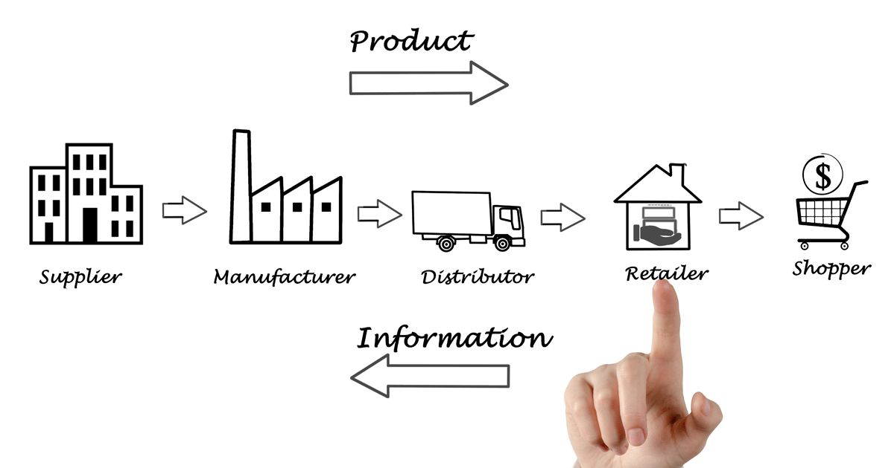
How Internet Security Impacts Supply Chain
According to the Infosec Institute, “Cyber security in the supply chain is a subset of supply chain security and is focused on the management of cyber security requirements for information technology systems, software, and networks, which are driven by threats such as cyber-terrorism, malware, data theft and the Advanced Persistent Threat (APT)”.
Supply chain cyber security attacks occur when someone infiltrates an organization through a third-party partner or provider, which is a glaring vulnerability as it is harder to guarantee that every level in the supply chain uses the same level of protection.
Common ways to protect an organization from supply chain cyber security attacks are by vetting vendors, continuously monitoring data access, training employees on internet security, and using multiple layers of protection.

Slide 5
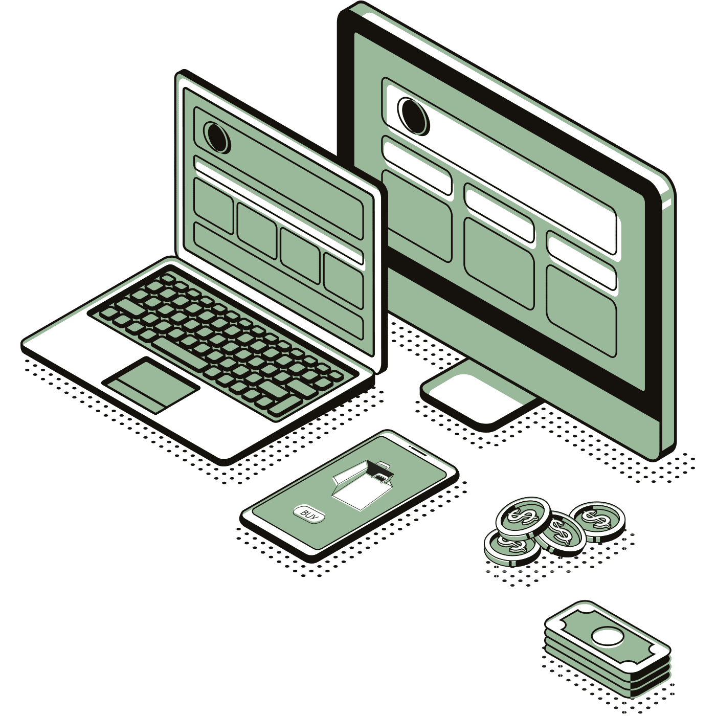
The change from manual to electronic logistical systems
To understand the situation with internet security as it pertains to supply chain management we need to acknowledge first how companies have come to need this security unlike they have in the past.
This need for internet security has grown as more of companies' logistical systems are being done in an online fashion and with software programming. This change has allowed manufacturers, suppliers, retailers and so on to gain many benefits as will be discussed later on
However in general these advances have made it easier to reduce human error within companies respective supply chains and have helped to enhance the performance and competitiveness of companies logistic systems

Slide 6
Identifying risk and the importance of internet security post this change
As this technology has been increasingly integrated within the supply chain, companies have also become more and more vulnerable to IT based attacks and hacking.
The importance of strong internet security in a companies supply chains is due to the fact that these systems present a weak link for cybersecurity; as organisations can’t always control the security measures taken by partners and thus hackers can jump between companies through whatever logistical based links these entities have.
To combat this, and when internet security is most effective, is when it is worked on in tandem with partnering companies as this can help to minimize those holes within the companies systems that hackers could use

Slide 7
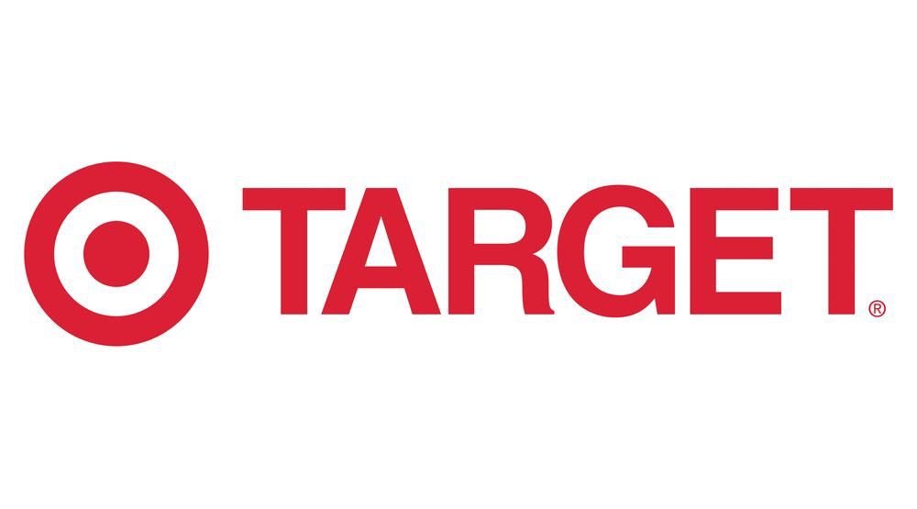
Cases of both strong and weak internet security
Research suggests that as much as 50% of all cyber attacks target supply chain
  The cost of these attacks on average are said to be about $1.1 million
  The different types of hacker attacks include, ransomware attacks, the losing of valuable proprietary information, commercial sabotage as well as a number of others
Cases of supply chains being hacked
  Target 2013
  Equifax

Slide 8
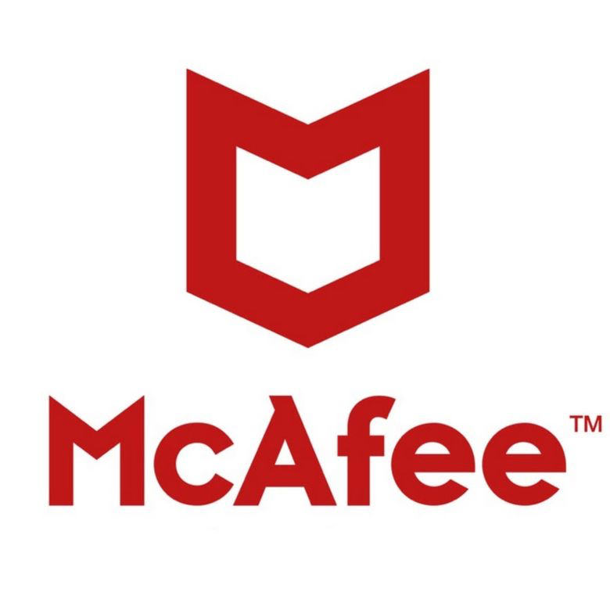
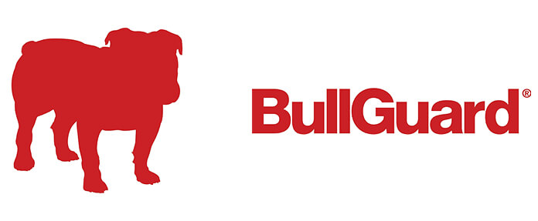
Benefits and Costs of internet security
Why is internet security important
  makes them feel secure and confident from any cyber criminal attacks
  Prevents malware and spyware
Best internet safety companies:
  Norton
  McAfee
  Bullguard
  Trend Micro

Slide 9
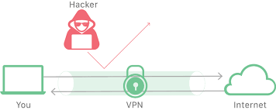
Benefits
Implementing internet security may be too complicated or not worth it to some people, but statistics have shown your private information and technology is safer with it.
protection from viruses
  The security system will an anti-malware software into your device
Protection from spyware
  Use anti-spyware software. Software is the front-line between you and an attacker.
Protection from identity theft
  Millions suffer each year from identity theft. Could be protected through anti-malware systems.

Slide 10
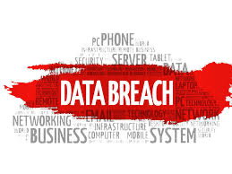
Risks of no internet security
code injections
  Code injection is the exploitation of a computer bug that is caused by processing invalid data.
Malware infection
  Malware is a type of software created with the intent of damaging the victim's computer, stealing private information or spying on a computer
Data breaches
  A data breach is an incident that exposes confidential or protected information. A data breach might involve the loss or theft of your Social Security number, bank account or credit card numbers, personal health information, passwords or email

Slide 11

Internet Expansion
The internet of things (IoT) continues to expand into new areas due to the growth of electronics in today’s society. There is a need for cybersecurity on almost any electronic in a household. Any new development in technology means there must be a new development in cybersecurity.
Because everything is interconnected there is a high risk for there to be a security breach. Around 2.53 billion people own a smartphone, and this number is expected to rise. This expansion of the internet means the demand for more cyber security with increase. Keeping up with this need in demand is challenging for the industry.

Slide 12

Under-development of employee education
Company culture has not yet caught up to the high risk of cyber-attack frequency and hacker capabilities. This is one of the biggest challenges faced in internet security, specifically for companies because their employees do not have the correct resources or tool to combat these issues.
A study conducted by Keeper Security on this topic showed that employee negligence caused 54% of breaches. Having a conversation sooner rather than later can help solve this issue. Companies need to incorporate a program to address these issues and offer ways for employees to identify any problems that may arise.

Slide 13
Real time information sharing
The pace of the internet world is a challenge to keep up with because of the increased need for security to protect against threats and weaknesses.
Addressing cybersecurity issues needs to be done in a timely manner to properly deal with protecting secure data. Seconds in the cyber world can do major damage and hackers are able to secure large quantities of data.
Speed is critical in an effective cybersecurity matter and having the correct education goes hand in hand with knowing the proper tools to deal with issues that may surface.

Slide 14
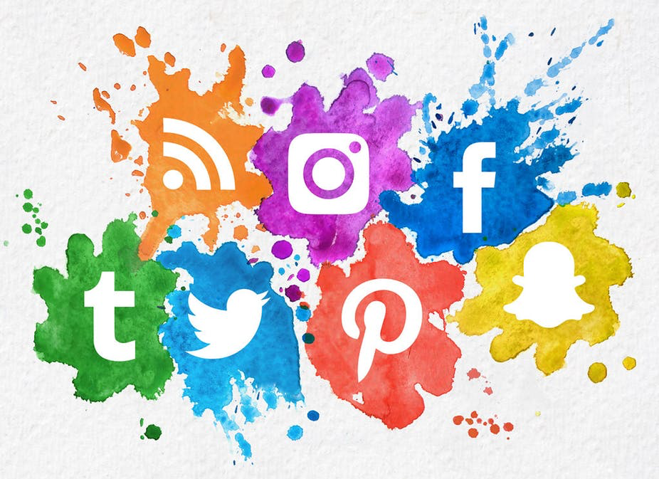
Accessibility
Businesses should utilize social media, websites and technology to help their businesses grow and reach as many people as possible
However, the more technology you tend to use, the more susceptible you are to data hacking
Internet security is not only to avoid current data attacks, but to adapt to future ones as well
Be prepared rather than paying for it later

Slide 15
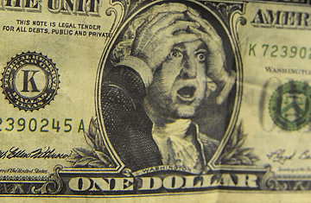
No cost now, heavy cost later
As stated earlier, many attacks are on supply chain and the costs are on average, over a million dollars
It is equally as important to make a short term profit as it is to make sure your profits can last in the long term
Once again, it makes sense to spend money that you will never see again to prevent lose everything to something you can never see coming
Cyber attacks are done before you know they happened
Money will go along with it

Slide 16
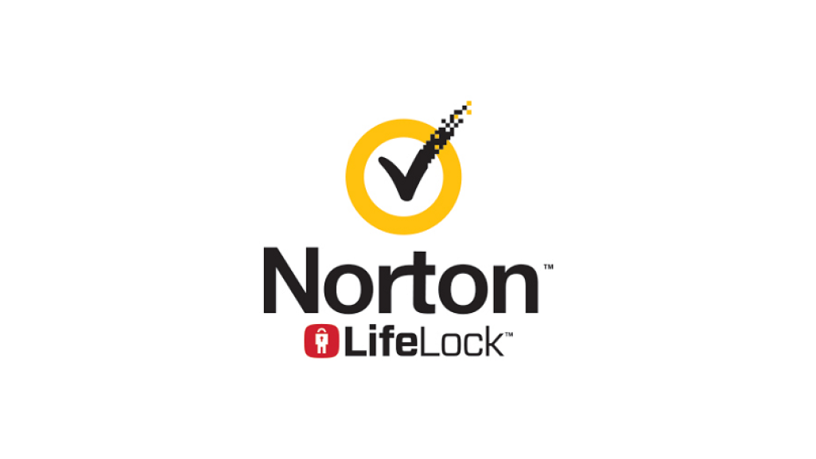
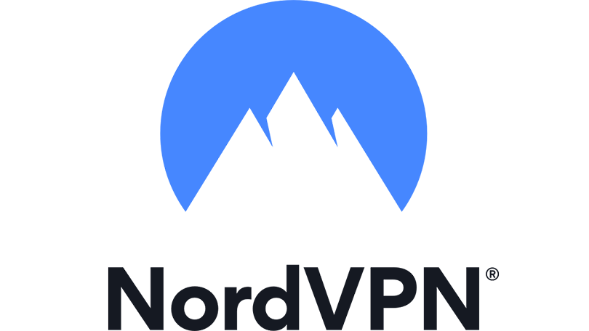
A Brighter Future
Utilizing top quality computer technology to prevent hackers at high cost outweighs the price that it costs to bounce back from internet breaches and eradicating viruses
Not only should this be used for business usage, but it will become ever more prevalent in personal use in things such as our own smartphones and laptops
Start by getting educated on cyber security and looking into the benefits of having a VPN as well as the backing of companies stated earlier, such as Norton or McAfee

Slide 17
Bibliography/Sources Pt. 1
https://www.mcafee.com/enterprise/en-us/security-awareness/cybersecurity/what-is-internet-security.html
https://www.itu.int/en/ITU-D/Statistics/Pages/stat/default.aspx
https://heimdalsecurity.com/blog/supply-chain-cyber-security/
https://resources.infosecinstitute.com/cyber-security-in-supply-chain-management-part-1/#gref
https://www.forbes.com/sites/andrewarnold/2018/05/26/how-the-internet-of-things-impacts-supply-chain/#3ed482f939b7
https://venturebeat.com/2020/01/08/5-reasons-why-supply-chain-security-must-be-on-your-agenda/
https://www.supplychaindigital.com/technology/supply-chain-remains-weakest-link-cybersecurity
https://en.wikipedia.org/wiki/Supply_chain_attack
https://www.csoonline.com/article/3444488/equifax-data-breach-faq-what-happened-who-was-affected-what-was-the-impact.html

Slide 18
Bibliography/Sources Pt. 2
https://www.nytimes.com/2019/07/22/business/equifax-settlement.html
https://www.thomasnet.com/insights/best-practices-for-supply-chain-cybersecurity/
http://brainiacsquad.com/why-do-we-need-internet-security/
https://owasp.org/www-community/attacks/Code_Injection
https://www.informationisbeautiful.net/visualizations/worlds-biggest-data-breaches-hacks/
https://codeburst.io/what-are-the-biggest-internet-security-challenges-for-2018-and-beyond-b7e2abe65840
https://www.forbes.com/sites/quora/2019/09/09/what-are-the-biggest-challenges-in-cybersecurity-right-now/#1ad611831444
https://www.weforum.org/agenda/2020/01/four-key-challenges-for-cybersecurity-leaders/
https://www.gao.gov/key_issues/ensuring_security_federal_information_systems/issue_summary
https://www.information-age.com/cyber-security-challenges-123474692/

